Slide 1
Measures to tackle early school leaving in Flanders
Koen Stassen
Flemish Education Council (Vlor)
Notes:
Introduction: as a member of the Vlor-secretariat, I was member of the working group that worked on the action plan. I wasn’t the author, but I think I am well placed to present it to you and to give my personal reflections on it.

Slide 2
ESL priority on the policy agenda
EU 2020: target < 10%
EU recommendation on policies to reduce ESL
PACT 2020: target < 4,3%
Policy advice from:
  Vlor (Educational stakeholders)
  SERV (socio-economic partners)
Plans for educational reform:
  Secondary education
  Dual system
  Adult education
  Guidance
Traineeships for Early School Leavers

Slide 3
10,5%
6,8%
Notes:
Definition: people that are not in education OR training. Positive: international comparision Negative: Sample / two components are measured within this indicator: ESL and LLL / difficult to measure the impact of policy initiatives because ages 18-24 are measured / not useful for monitoring because of reliability intervals of the data (sample)

Slide 4
13,6%
11,1%
8,6%

Slide 7
Contributing factors to ESL
ESL = cumulative process
Contributing factors:
  Well-being
  Socio-economic background
  Ethnic background
  Gender
  Grade retention
  Pull-factors on labour market
  School absence
  Exclusion

Slide 8
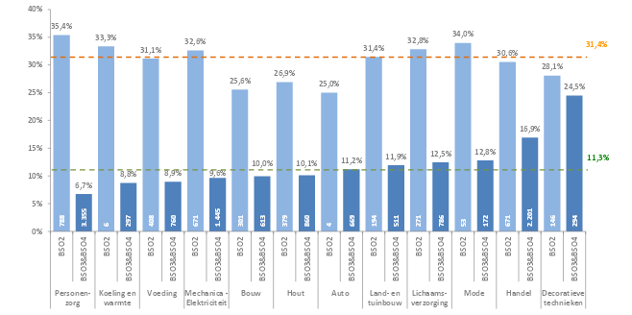
Impact of ESL on transition to work
Notes:
Care / Average

Slide 9
Action plan on ESL
Different ministers and ministries involved
Integrated action and coherent approach on flemish level needed
  → action plan on ESL
Task force with representatives of:
  Ministries of education and labour
  Social partners
  Educational providers
  Advisory bodies (Vlor & SERV)
  Public training providers

Slide 10
Three main principles
  European framework
    Identification/ monitoring / policy coordination
    Prevention
    Intervention
    Compensation
  Quick wins combined with actions on the long run
    Sustainability of the actions = crucial
  Every pupil has to reach a full qualification
    Ambitious ESL-target < 4,3% is not sufficient

Slide 11
1. Identification & monitoring
Scientific research
  Monitoring at flemish level
  More detailed data on regional level
Provide schools with data on ESL
Collect detailed data on the transition between education and labour market

Slide 12
2. Prevention (1)
Provide school with data on ESL
  For internal quality assurance
  School management is able to interpret data
  And take concrete action
School inspectorate will focus on ESL
Inform schools on ESL
Flexible learning paths in secondary education:
  Inform schools about the legal possibilities
  Communicate good practices
  Support to implement flexible learning paths

Slide 13
2. Prevention (2)
Improvement of the dual system
  Evaluation of the 2009-reform
  Improvement of the work-component
Obligation to integrate workbased learning in vocational tracks
Cooperation with PES (VDAB) for vocational training
Sensibilisation of employers to not hire students without a full qualification
Implementation of a qualifications framework (attractive curricula, LLL, RPL)

Slide 14
3. Intervention
Communicate good practices on tutoring / peer coaching
Projects on transition education-labour market for specific groups
4. Compensation
Promotion of adult education
Cooperation between educational and public training providers
Promotion of RPL

Slide 15
Coordination
Provide a scenario for regional cooperation between schools, guidance centres, public employment service and other relevant partners to tackle ESL
Monitoring of the action plan

Slide 16
Personal reflections (1)
The action plan is developed
Vlor put ESL on the agenda since 2009 but misses clear policy choices on f.e.:
  Guidance
  Structural support for Time-out projects
  Involvement of all relevant partners
Ownership
  No carrot nor stick
  Large autonomy for educational providers
Indirect actions to improve motivation
Notes:
Not very ambitious plan. Main reason to develop the plan? Because the commission set the date at 2012 or to really tackle the problem? No incentives /
Relevante partners: ministers of work, care health // social partners // were not involved, not committed.

Slide 17
Personal reflections (2)
Professional qualification vs education?
Reform plans:
  Structural approach
  So far no sufficient answers
Perspective of children with immigrant background – Sirius round table
General vs targeted approach?
Quick wins vs long term investment?
Elections in 2014. Direction of reform plans?

Slide 18
Contact
koen.stassen@vlor.be

